Slide 1
Outline for today
2-color channel now gives proper mosaics
Are surrounds weaker?
Changes/Improvements to DoG fits

Slide 2
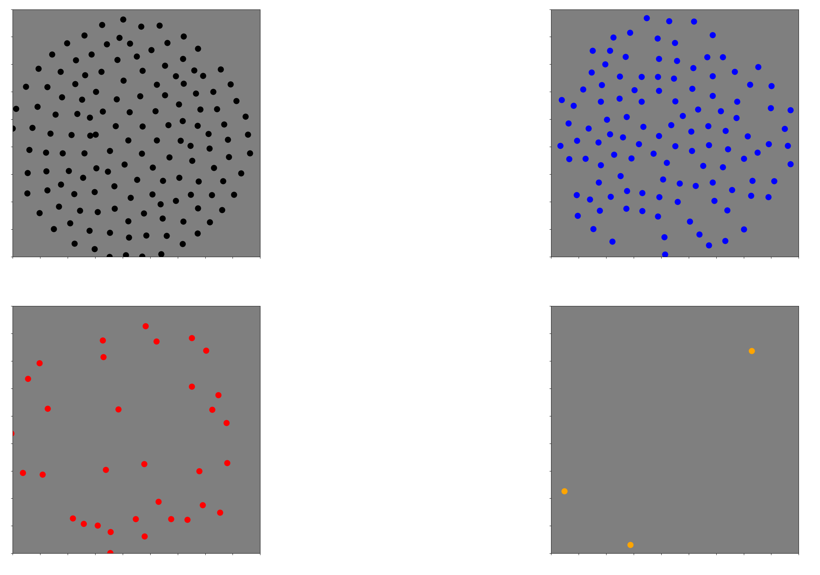
Before: 2-channel mosaics

Slide 3
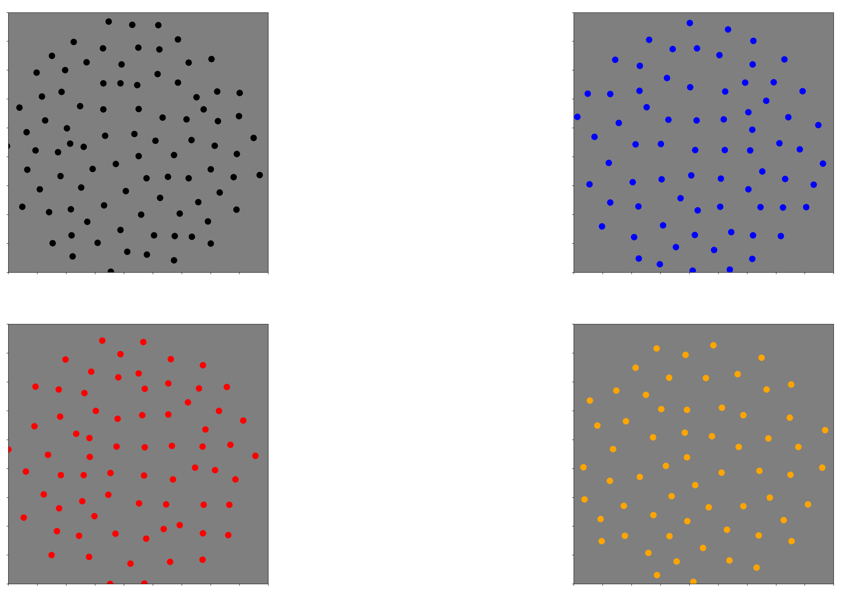
Now: 2 channel mosaics
'240301-055438'

Slide 4
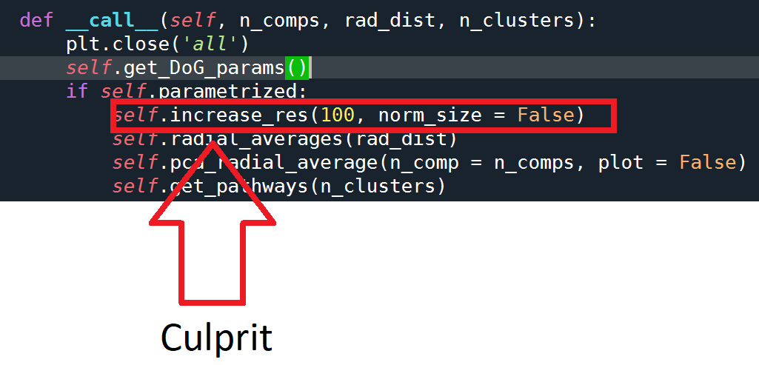
What changed?

Slide 5
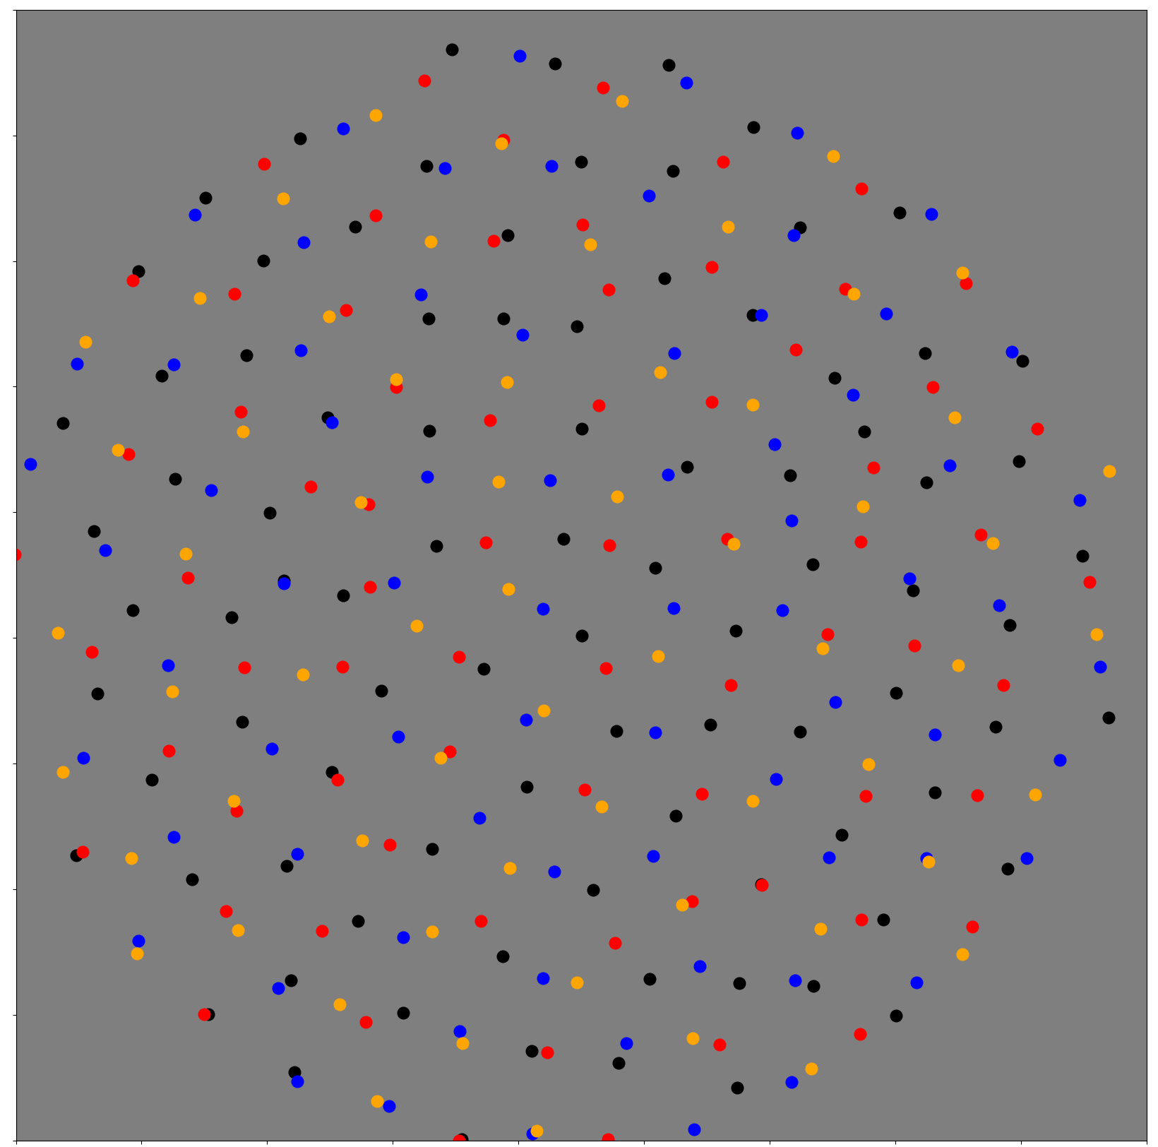

Slide 6
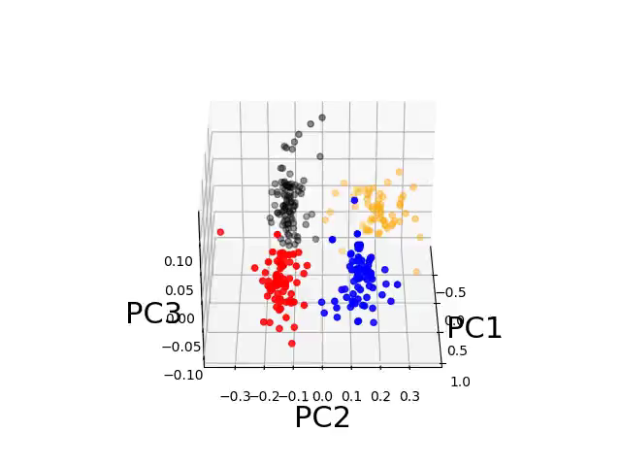

Slide 7
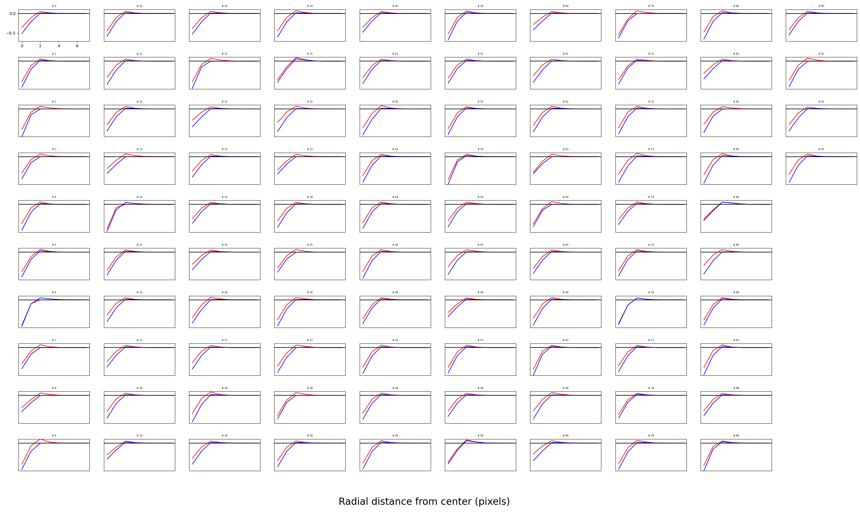
OFF parasol

Slide 8
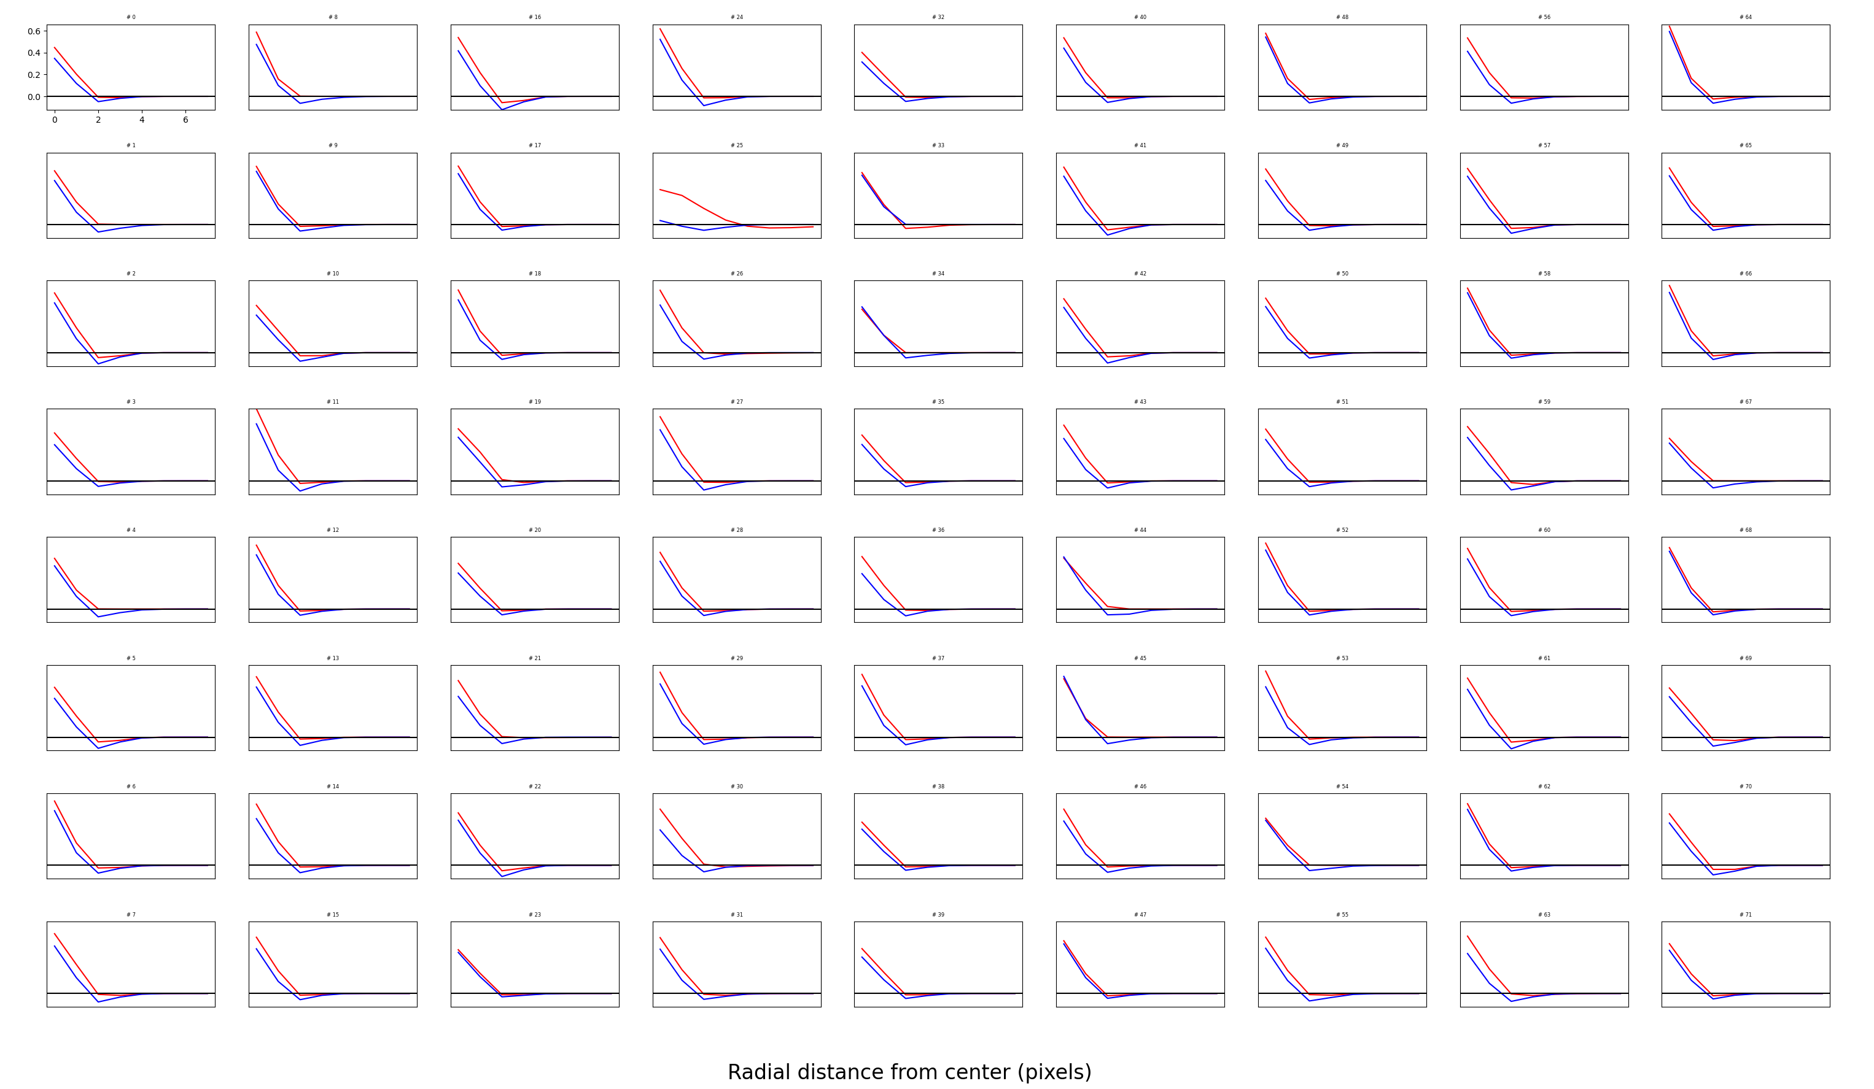
ON parasol

Slide 9
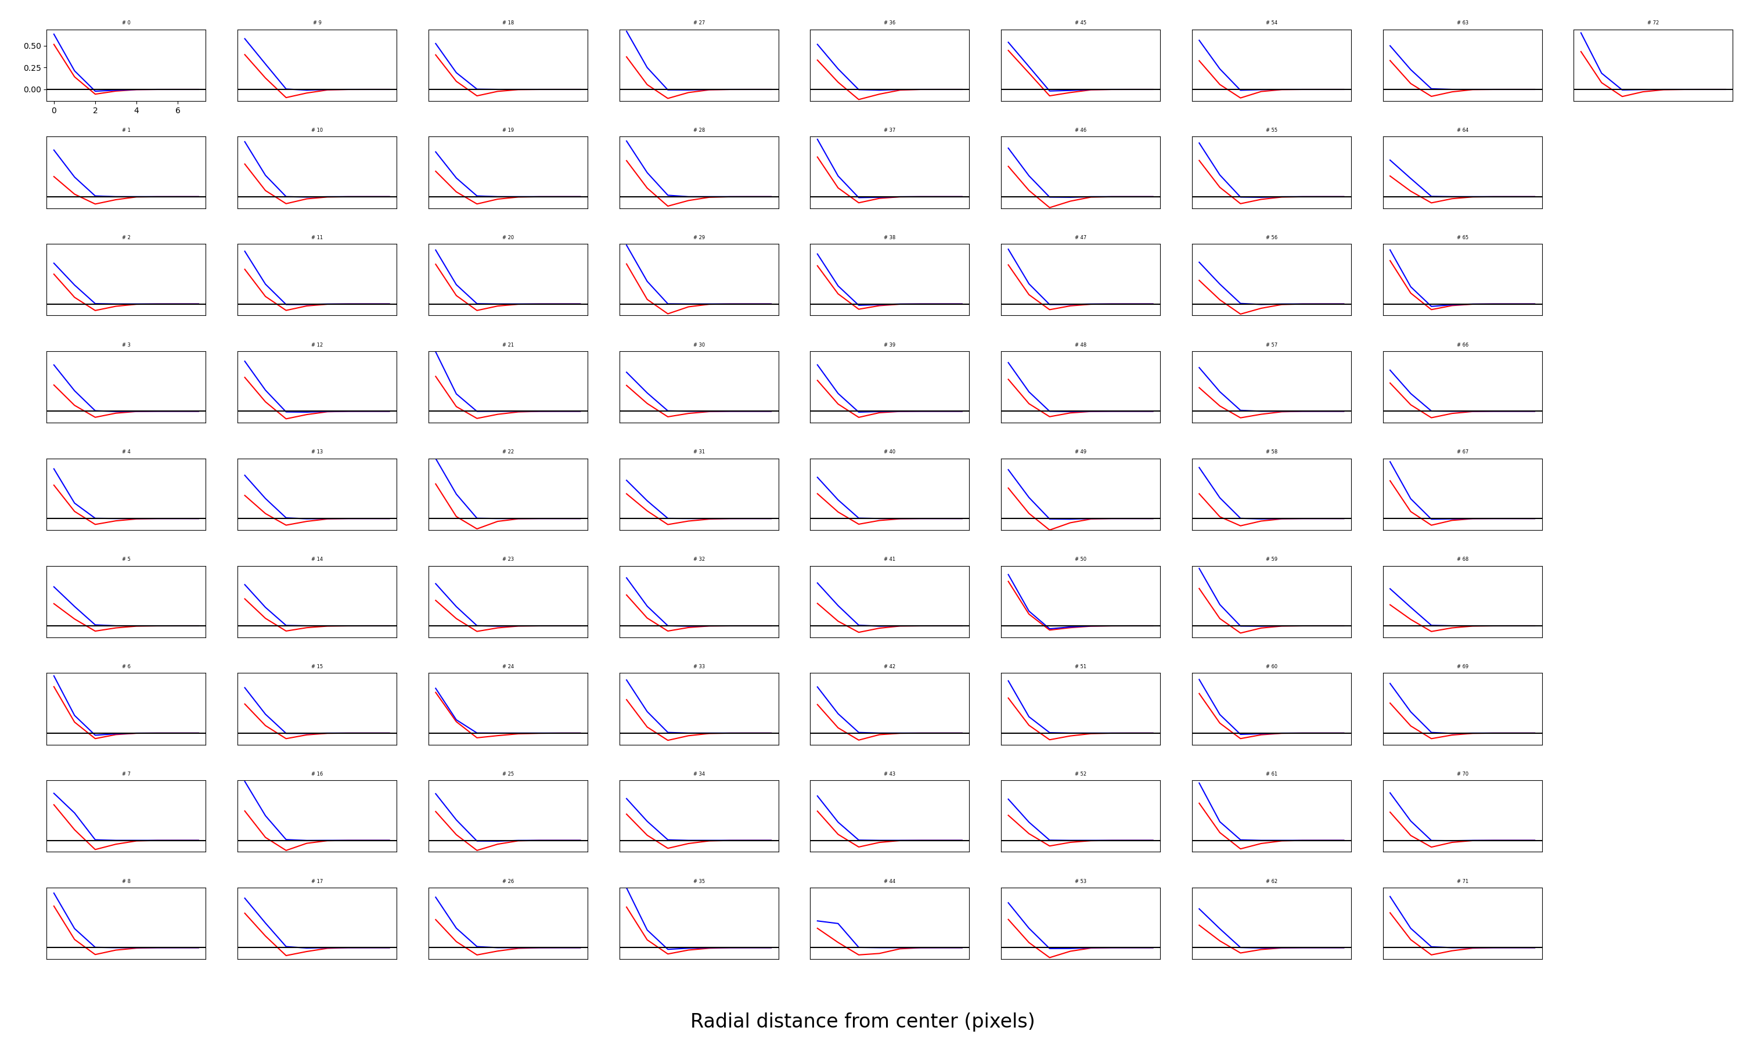
ON pathway #2

Slide 10
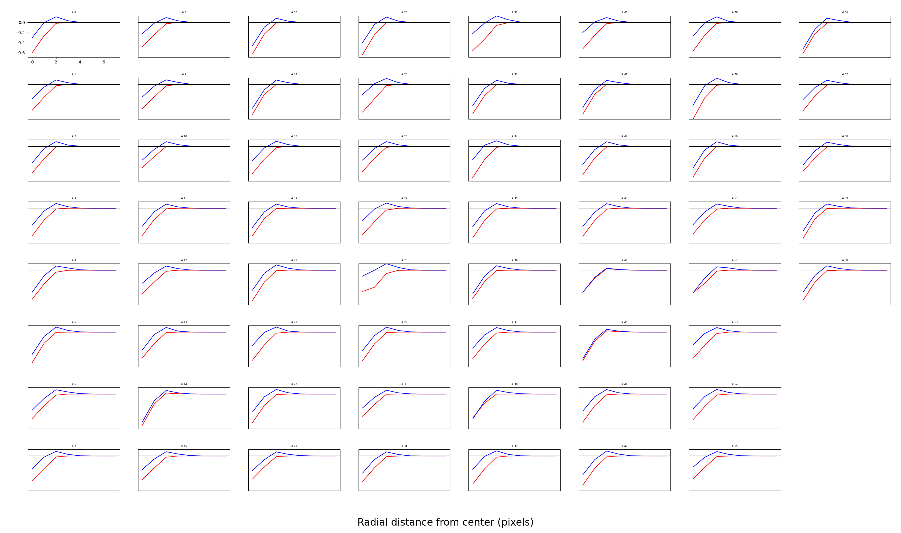
OFF pathway #2

Slide 11
Changing input and output noise
We get weak surrounds and weak color opponency: maybe we need to lower noise?
Original: Output = 3, input = 0.4
What you just saw: Output = 2, input = 0.2
What I’m about to show: Output = 1, input = 0.05.

Slide 12
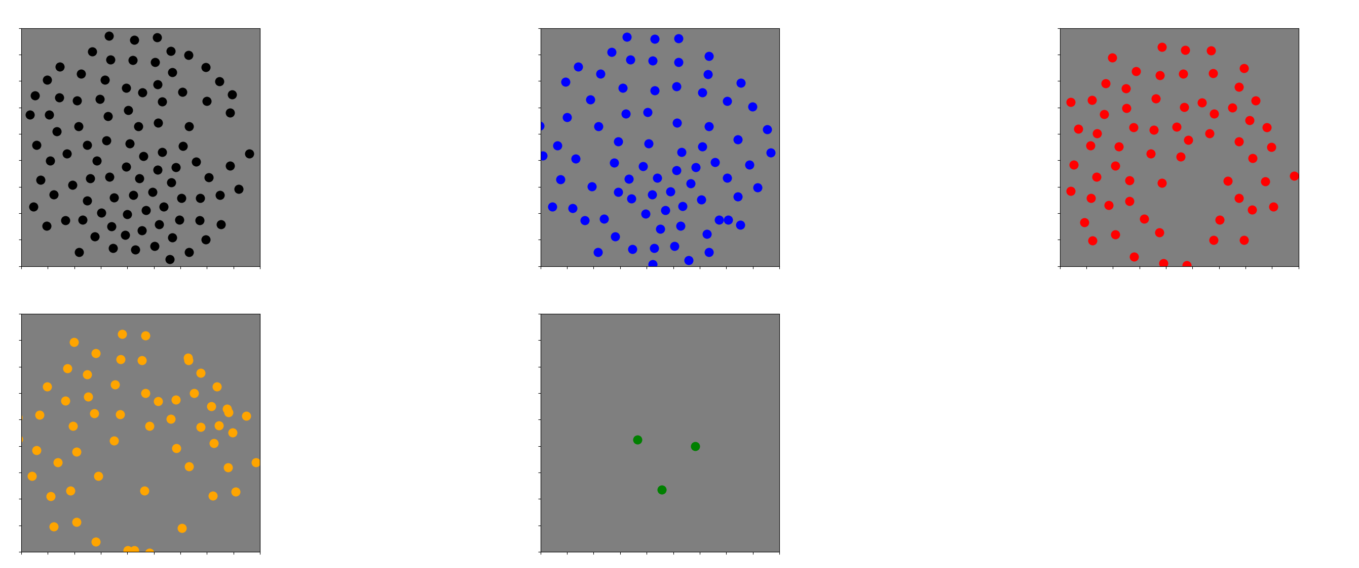
240303-202020

Slide 13
Notes
As we go from mosaic 1 to mosaic 5:
Surrounds become stronger
Color opponency becomes stronger

Slide 14
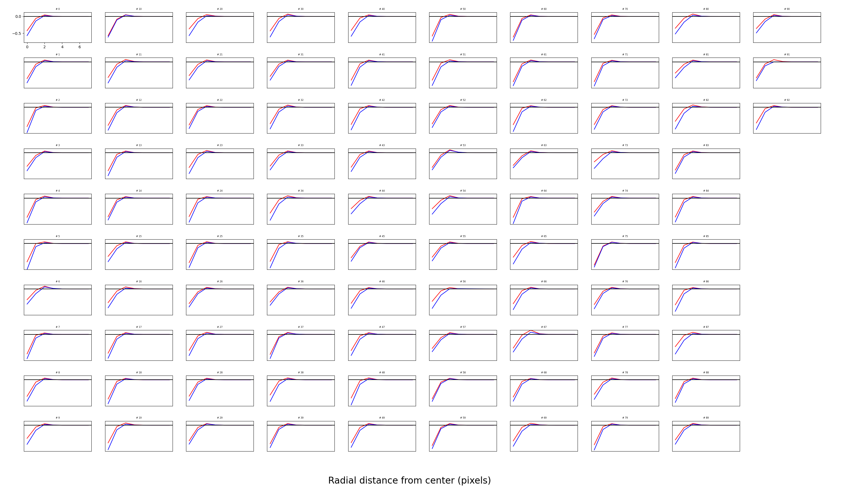
Mosaic 1

Slide 15
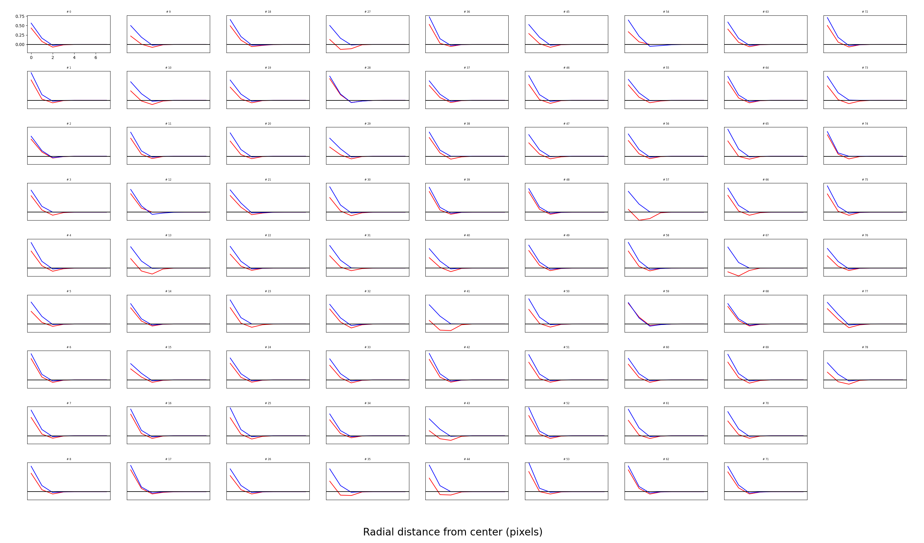
Mosaic 2

Slide 16
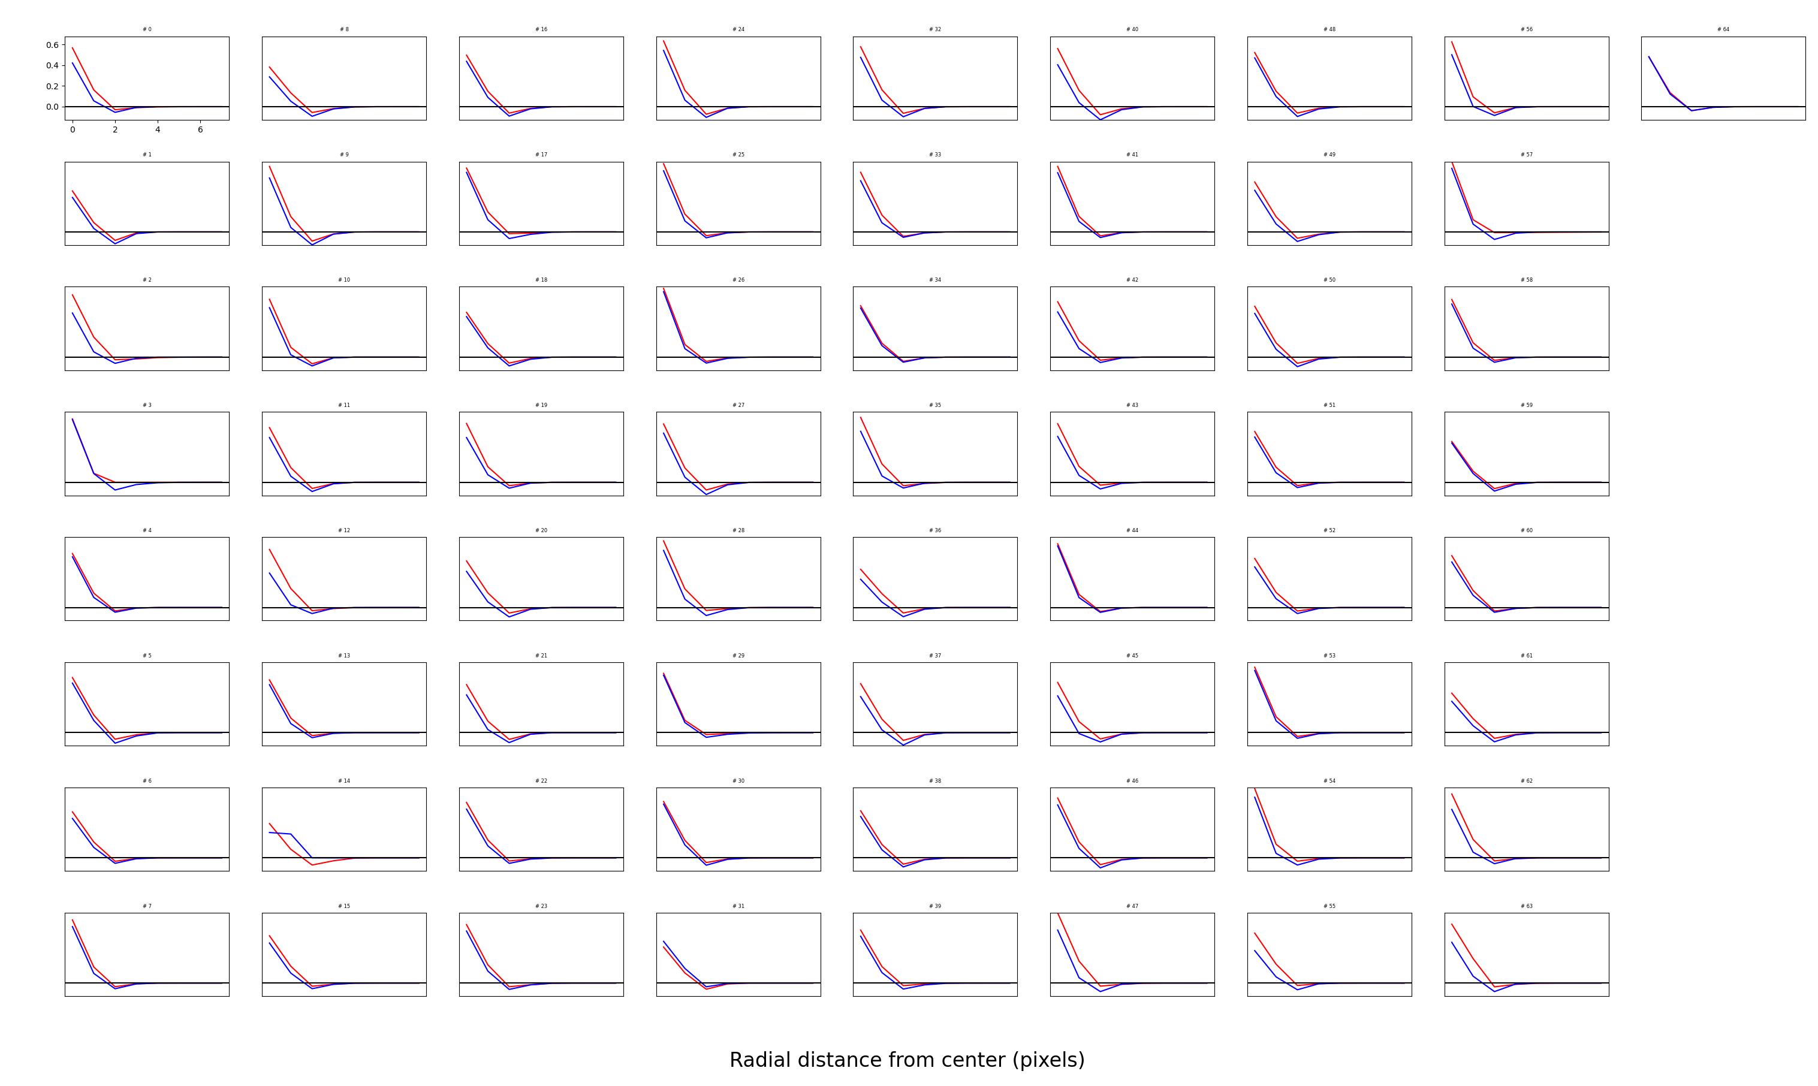
Mosaic 3

Slide 17
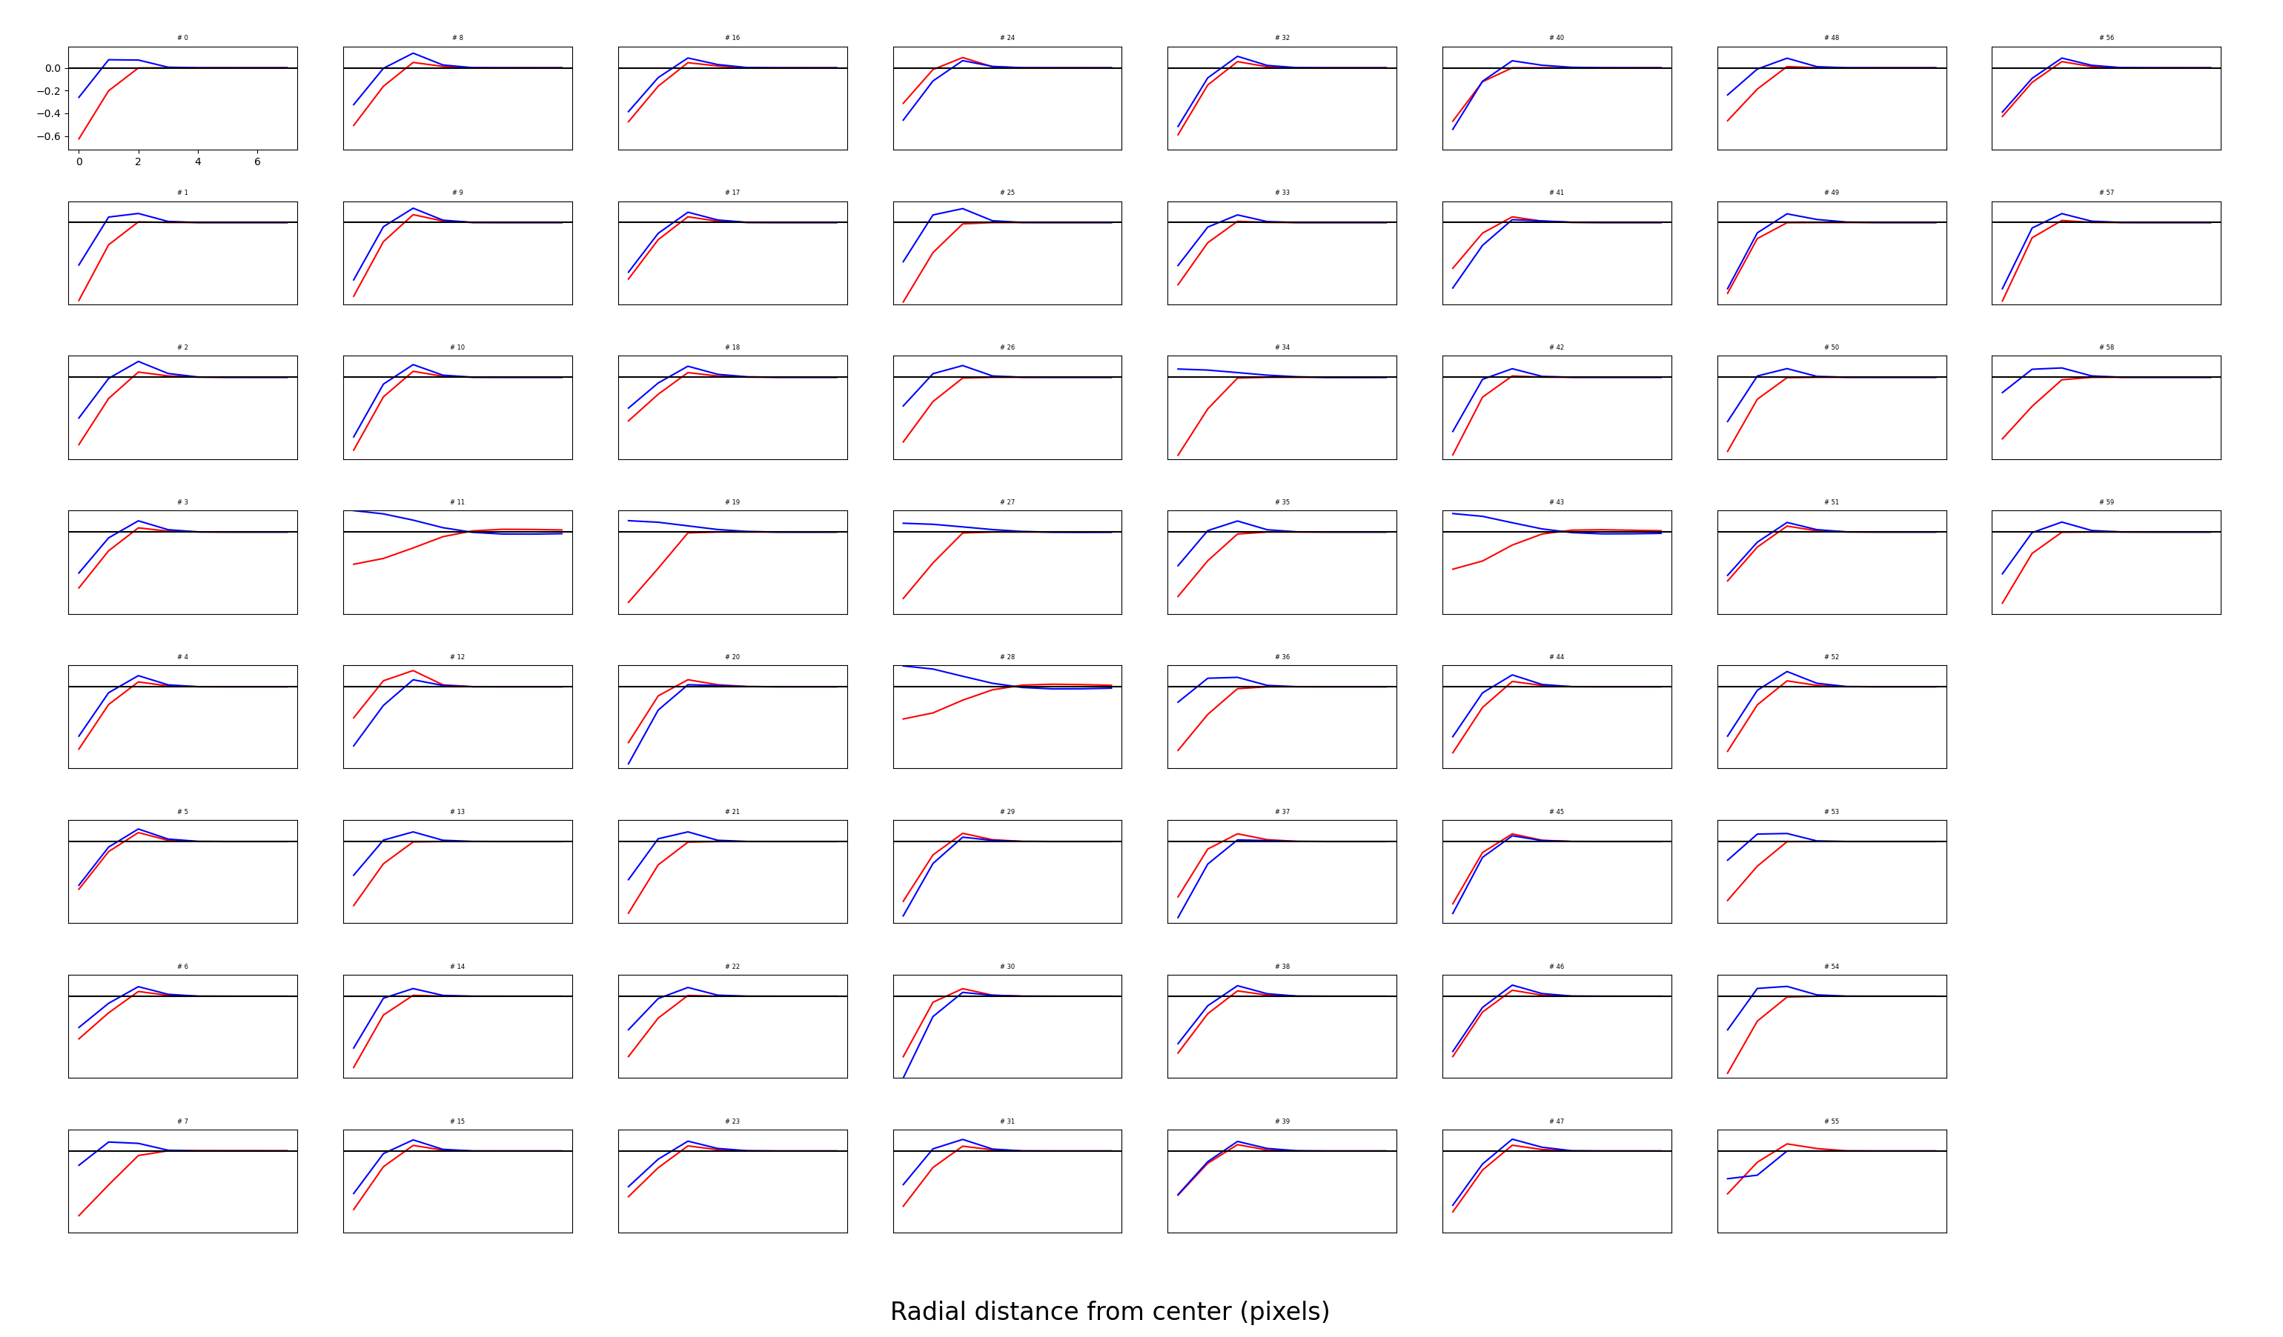
4th mosaic, quite a few opponent cells

Slide 18
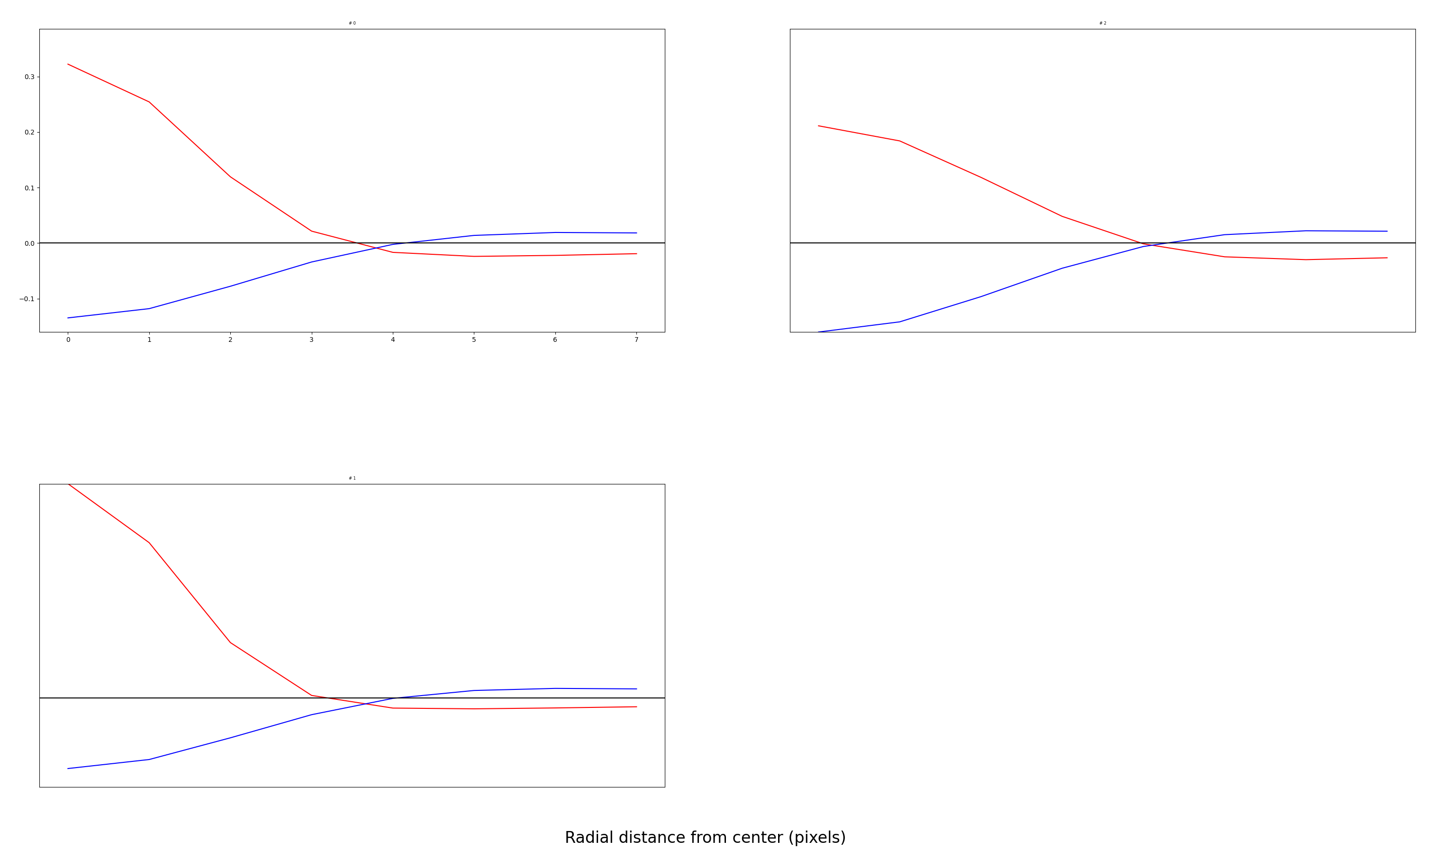
5th mosaic

Slide 19
Notes
Seems like I still need to lower noise to get more opponency
3 channels experiment still don’t make clean mosaics

Slide 20
Are surrounds weaker?
No they are not

Slide 21
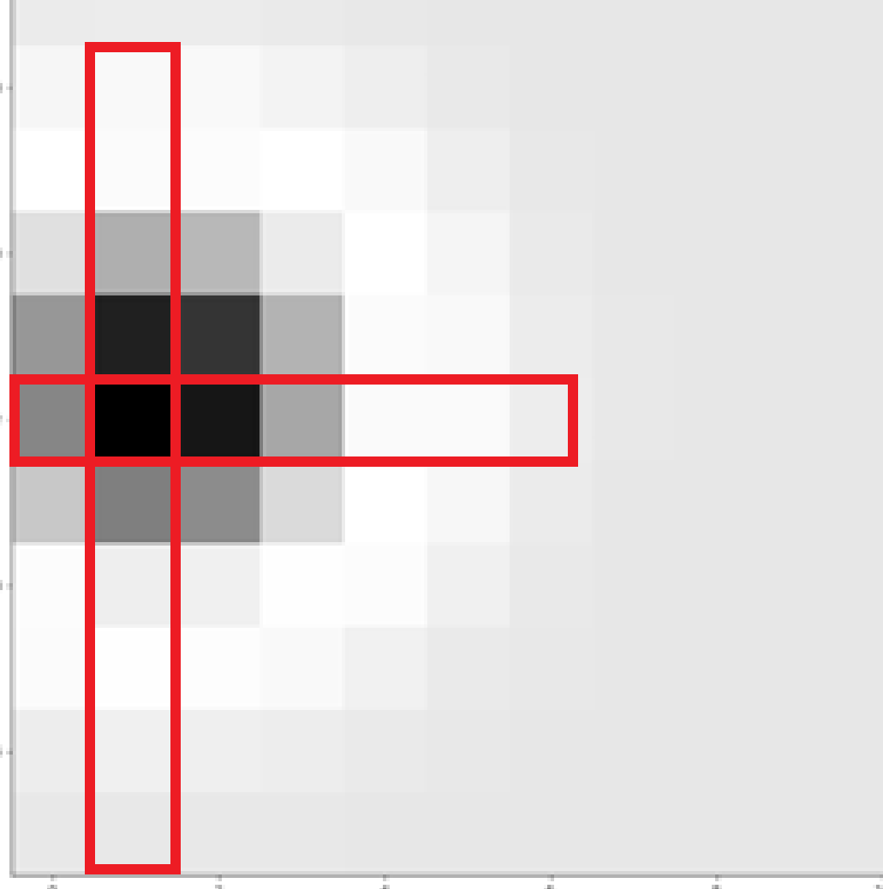
How I compute radial averages makes surrounds seem weaker than they are

Slide 22
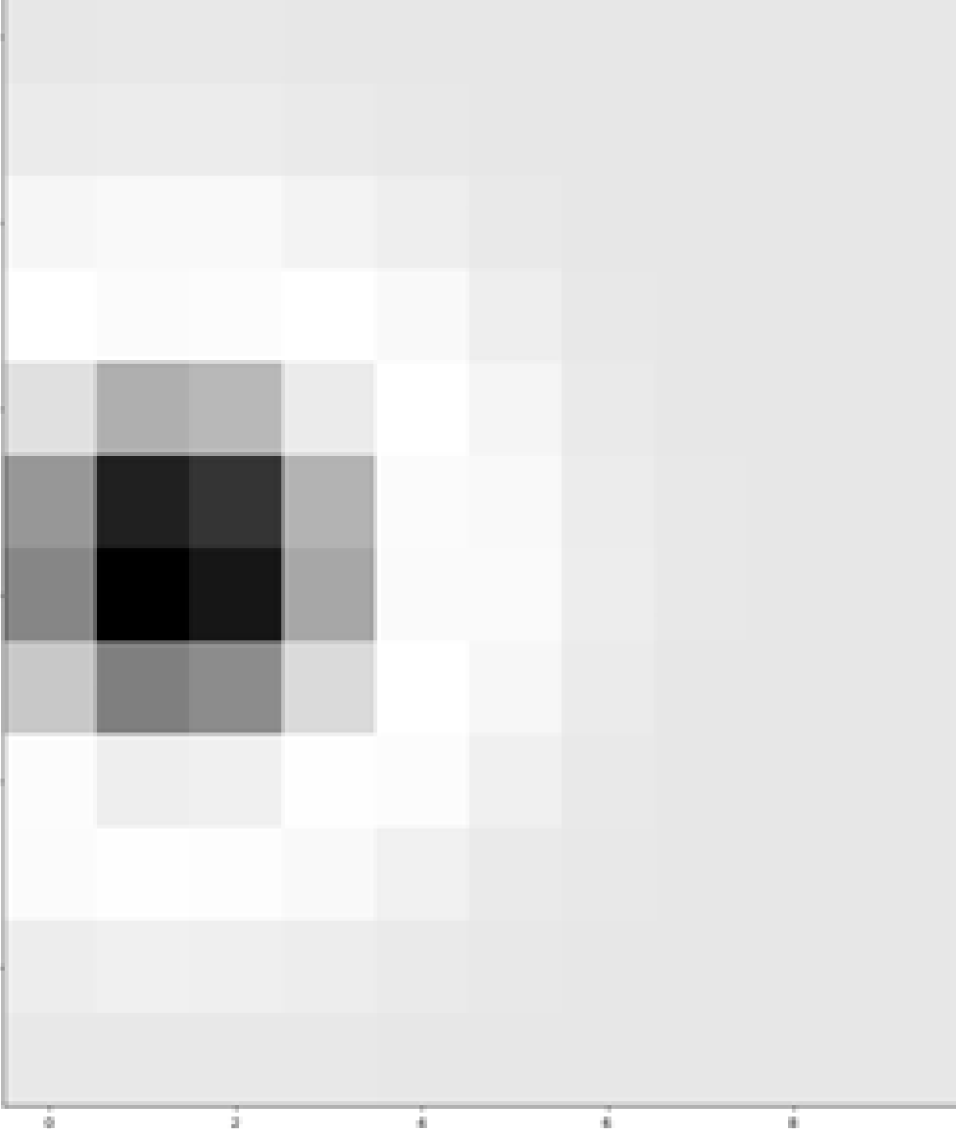
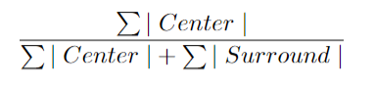
Center surround ratio index

Slide 23
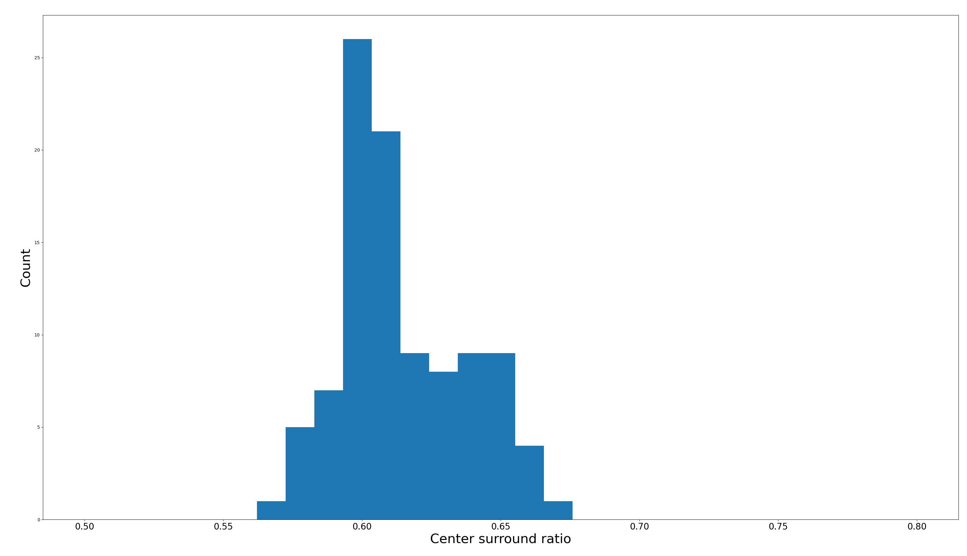
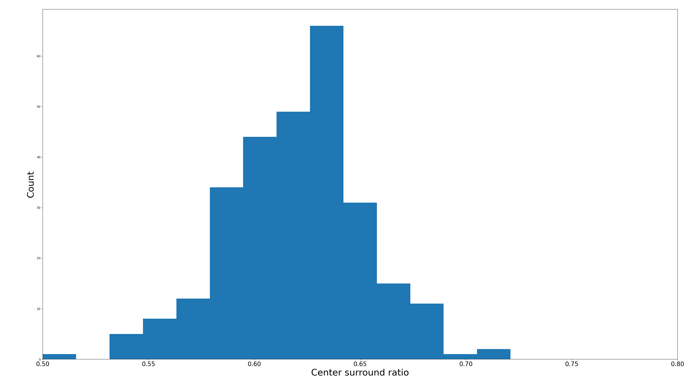
Nayoung’s model. Input noise = 0.4
2 color channels. Input noise = 0.2

Slide 24
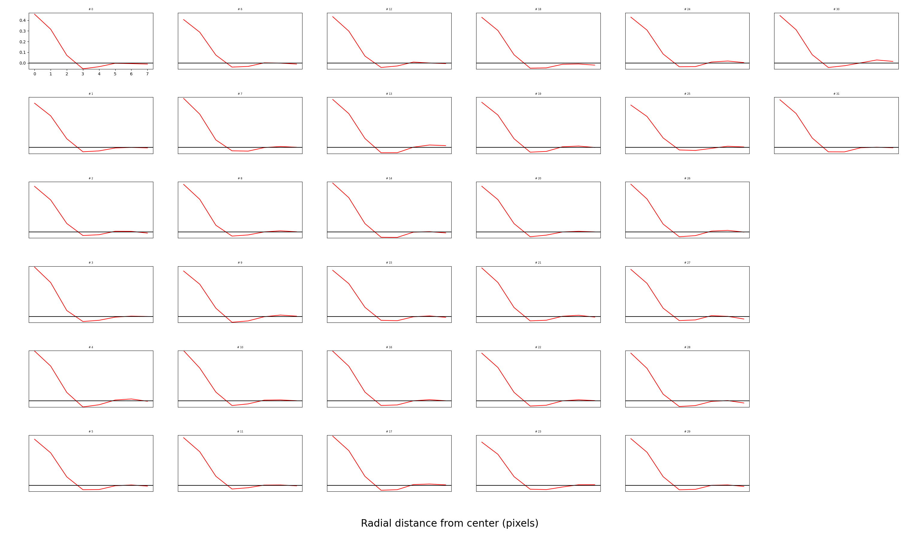
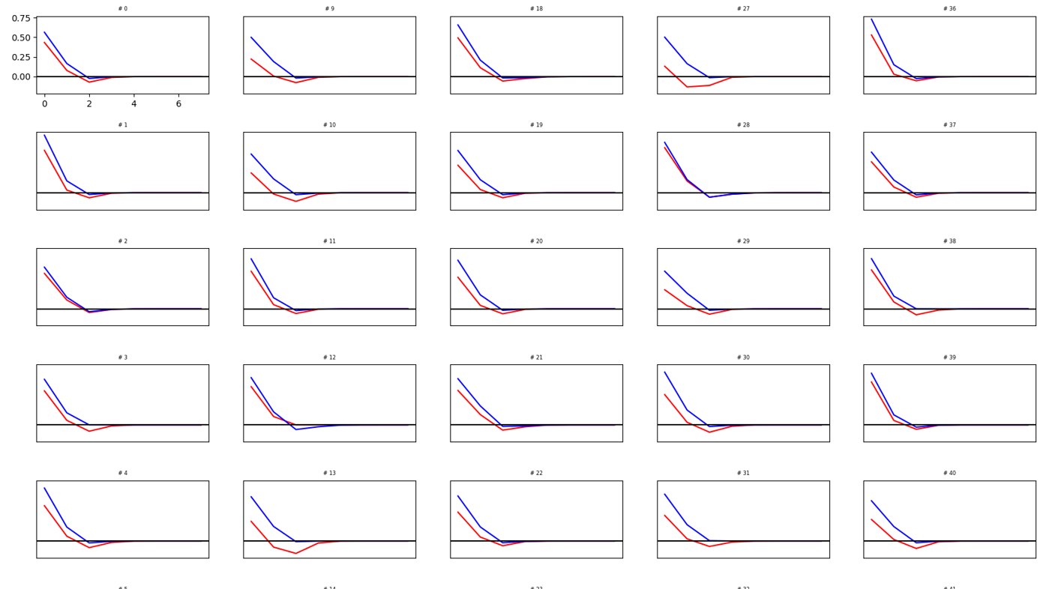
Nayoung’s model
2 color channels

Slide 25
Changes/Improvements to DoG fits

Slide 26
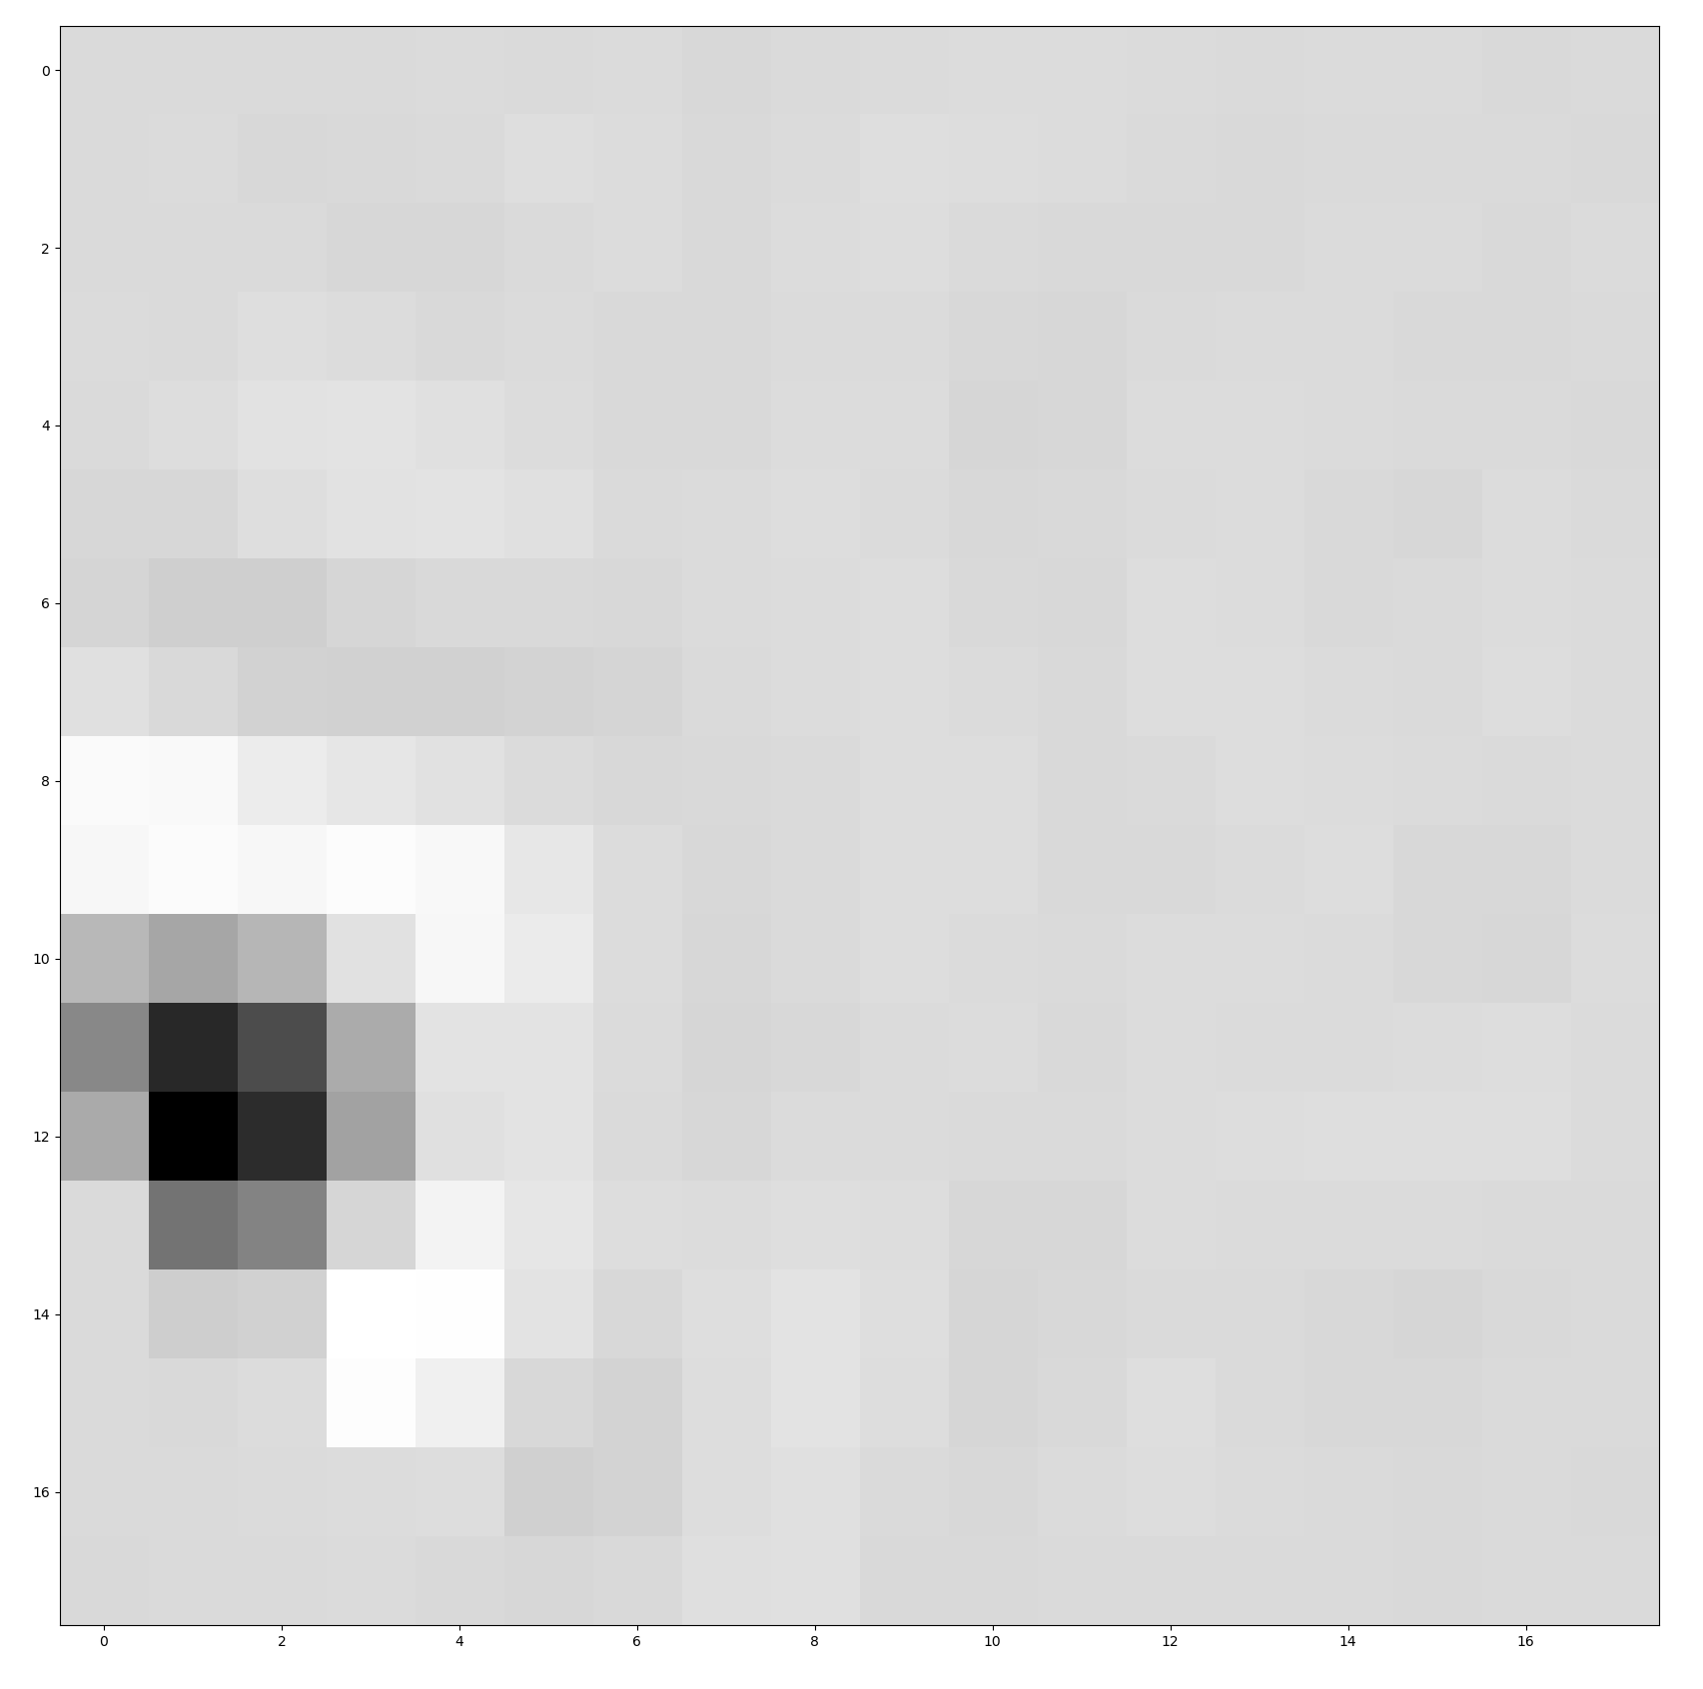
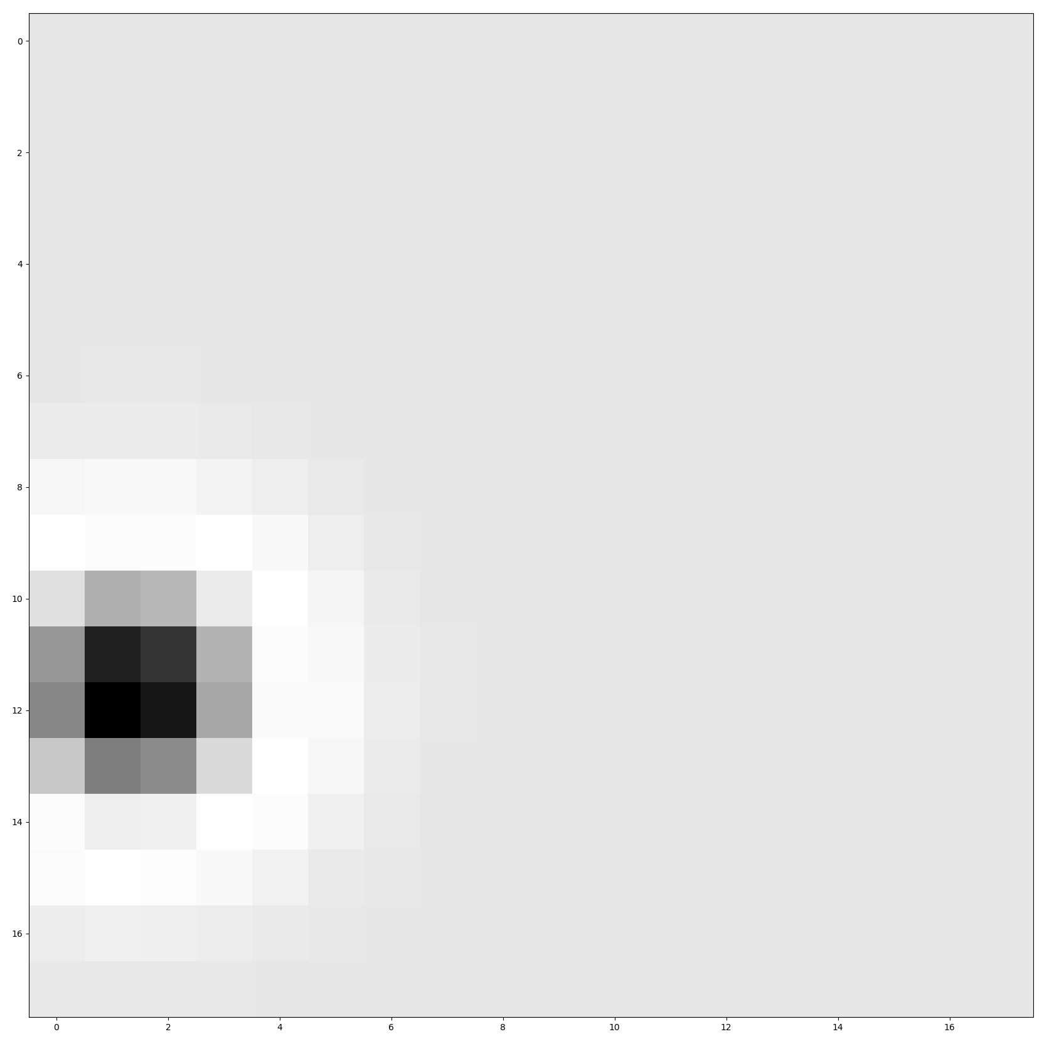
Trying to fit DoG to unparametrized RFs

Slide 27
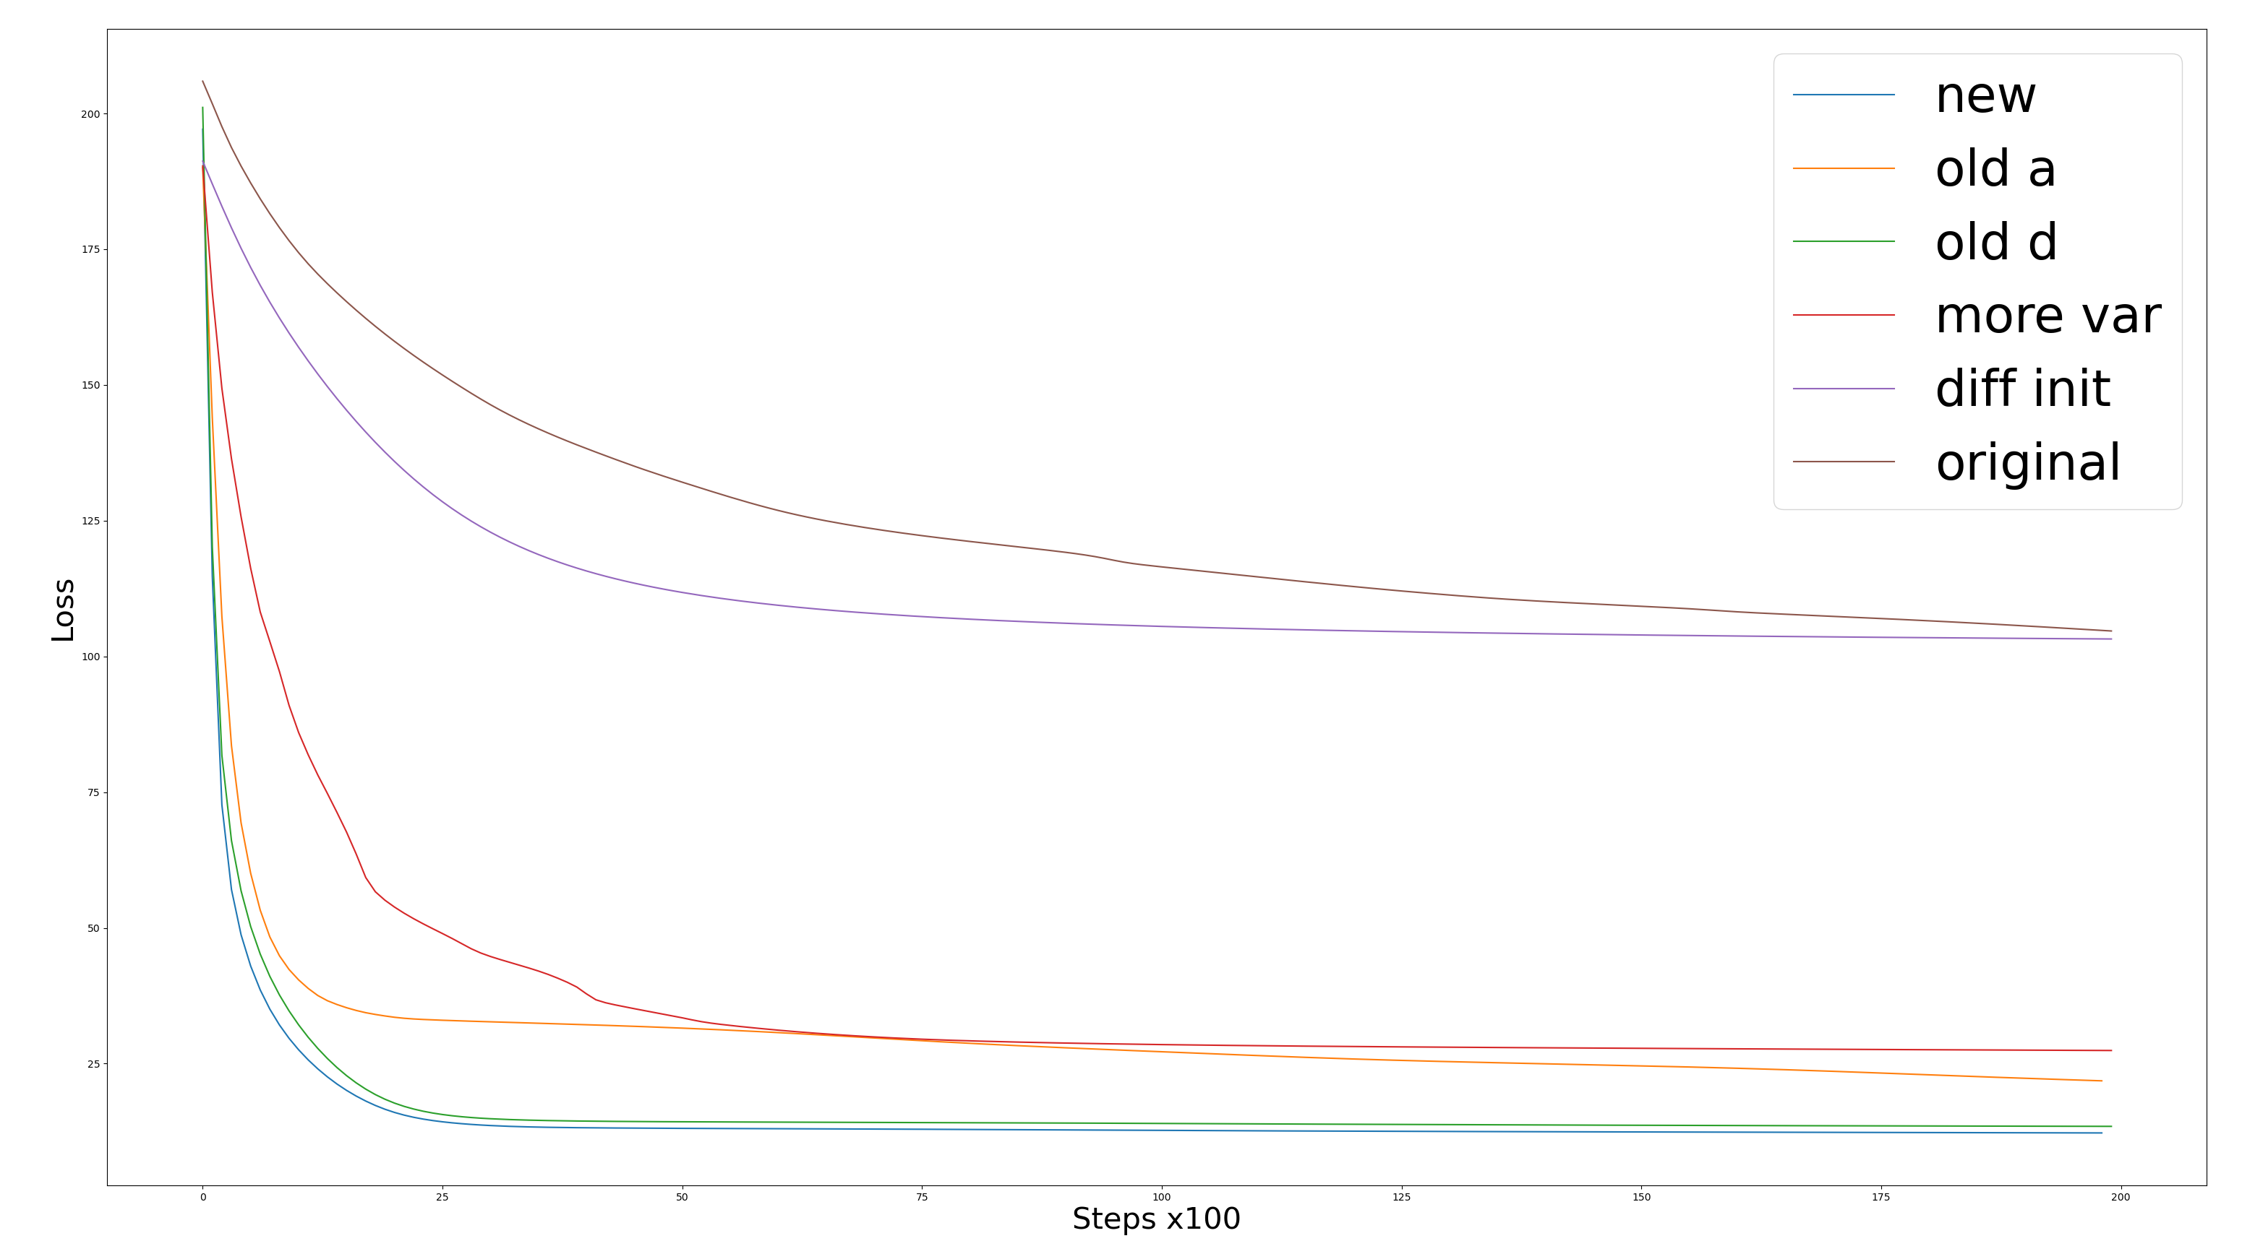

Slide 28
List of changes
1- Diff init: Initialized center and surround to be larger
2- more var: Initial parameter values are drawn from a Gaussian with 10x less variance
3- old d: d parameter is switched from having its norm = 1 to being a sigmoid
4- old a: a = a_pre + b -> b = 1/(1/a + 1/b)

Slide 29
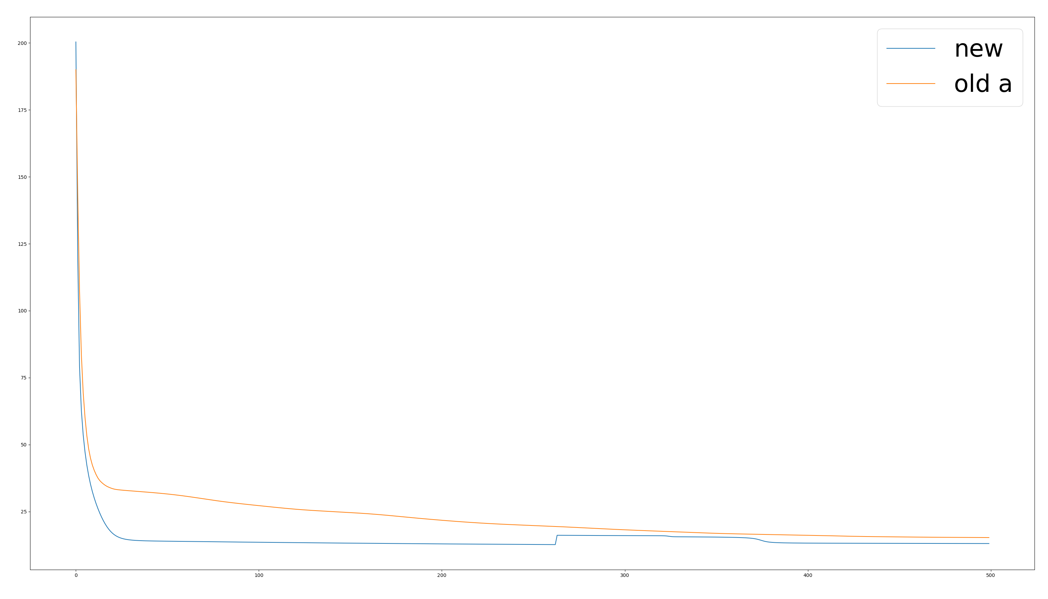
Old a vs new a : more steps

